Slide 1


Cloud Infrastructure Week#3
Emrah Mutlu
January 2024

Slide 2
AGENDA – WEEK#3
Cloud Computing Services
Virtual Machines (VMs)
Virtual Machine Scale Sets (VMSS)
Dedicated Hosts
Virtual Desktop Solutions & RDS
Azure VMWare Cloud Solution
High Performance Computing (HPC)
App Services
Lab Sessions:
Lab: Testing compute instances on Cloud

Slide 3
Computing Services

Slide 4
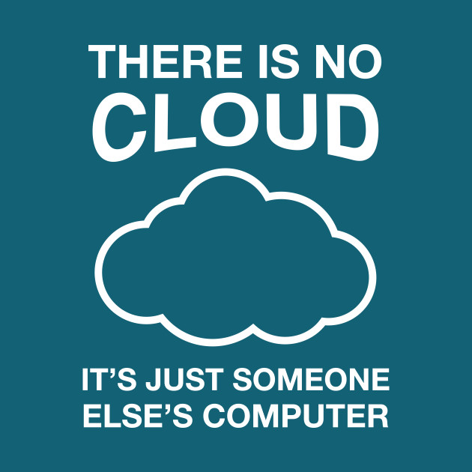
CLOUD COMPUTING
Cloud vendors (Azure) provide the following Compute resources:
Virtual Machines (VMs)
Virtual Machine Scale Sets (VMSS)
Dedicated Hosts
Virtual Desktop Solutions & RDS
Azure VMWare Cloud Solution
High Performance Computing (HPC)
App Services
Week#4:
Container Instances
Kubernetes (K8s) Services / AKS
Serverless Solutions
Infrastructure Automation:
Homework

Slide 5
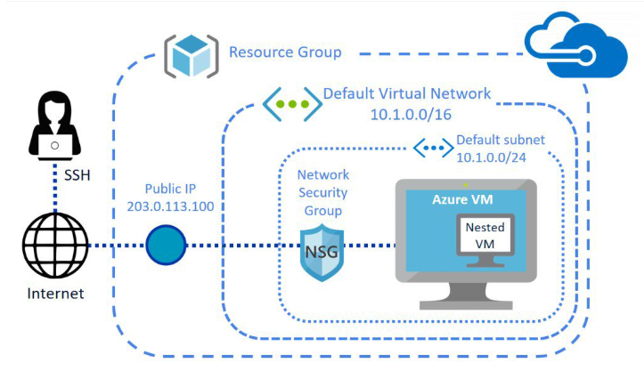
VIRTUAL MACHINES
The simplest way to use the cloud compute resources. You could build and use virtual machines in the Cloud in a few minutes.
The type is IaaS; therefore, the user needs to maintain the O/S, middleware, application, etc.
VMs are ideal when you need;
Total control of the O/S
The ability to run the custom software
To use custom hosting configurations
Use cases:
Testing and Development
Running apps on Cloud
Extending the existing datacenter to the Cloud
Disaster recovery purposes
Moving to VM Method: Lift & Shift

Slide 6
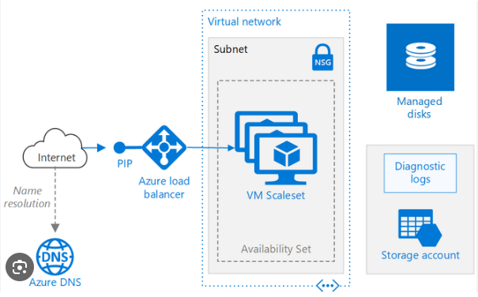
VIRTUAL MACHINES SCALE SETS (VMSS)
The simplest way to use the scaling mechanism on VMs.
The type is IaaS; therefore, the user needs to maintain the O/S, middleware, application, etc.
VMs should be identical and supports load-balancing (max. VM capacity is 1000 VMs).
Allows HA (High-Available) solution with auto-scaling and scheduled scaling options.
Auto scaling depends on the metrics available on the Cloud (i.e. CPU, Memory, I/O usage).
Scheduled scaling is to support forecasted high demand scenario.
VMSS is ideal when you need;
Still a VM but also need auto-scaling
The workload could be shared across identical VMs
Large scale services to process big data

Slide 7
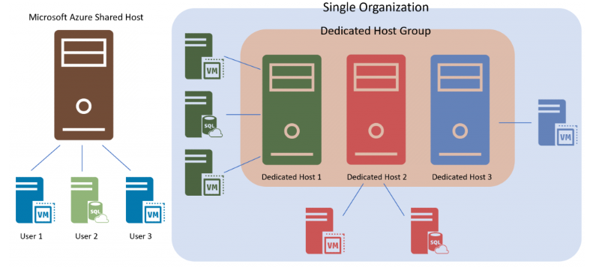
DEDICATED HOST
Normally, VMs are in Shared Host services.
Dedicated host service allows to dedicate the whole host to your organization.
Dedicated host is ideal when you need;
Improved security & Hardware isolation.
Generally looking for a long term contract with Cloud vendor / CapEx.
Control over support events initiated by the Cloud vendor.
Control the whole host maintenance.
Business critical applications are on a single host environment.
Different O/S on a single host.
Comply with your organization’s corporate policies.
Bring your own license (BYoL) feature on Azure for both O/S and databases.

Slide 8
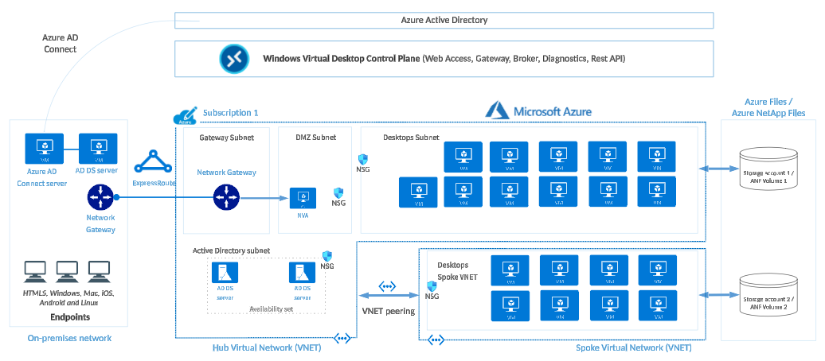
Virtual Desktop Solutions
Azure provides Virtual Desktops to the Enterprises; therefore, they can manage the VMs, data and the clients.
Ideal for;
Security and regulation applications, such as financial services, healthcare, and government.
Elastic workforce needs, such as remote work, mergers and acquisitions, short-term employees, contractors, and partner access.
Specific employees, such as bring your own device (BYOD) and mobile users, call centers, and branch workers.
Specialized workloads, such as design and engineering, legacy apps, and software development testing.

Slide 9
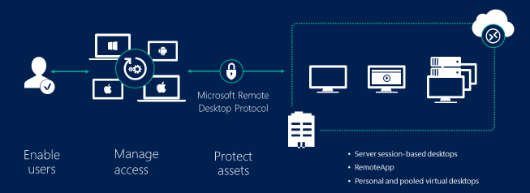
RDS (Remote Desktop Services)
Azure provides Remote Desktop Services for;
Better security with Session-based authentication
Keep the data in Cloud
Keep the VMs in the DMZ

Slide 10
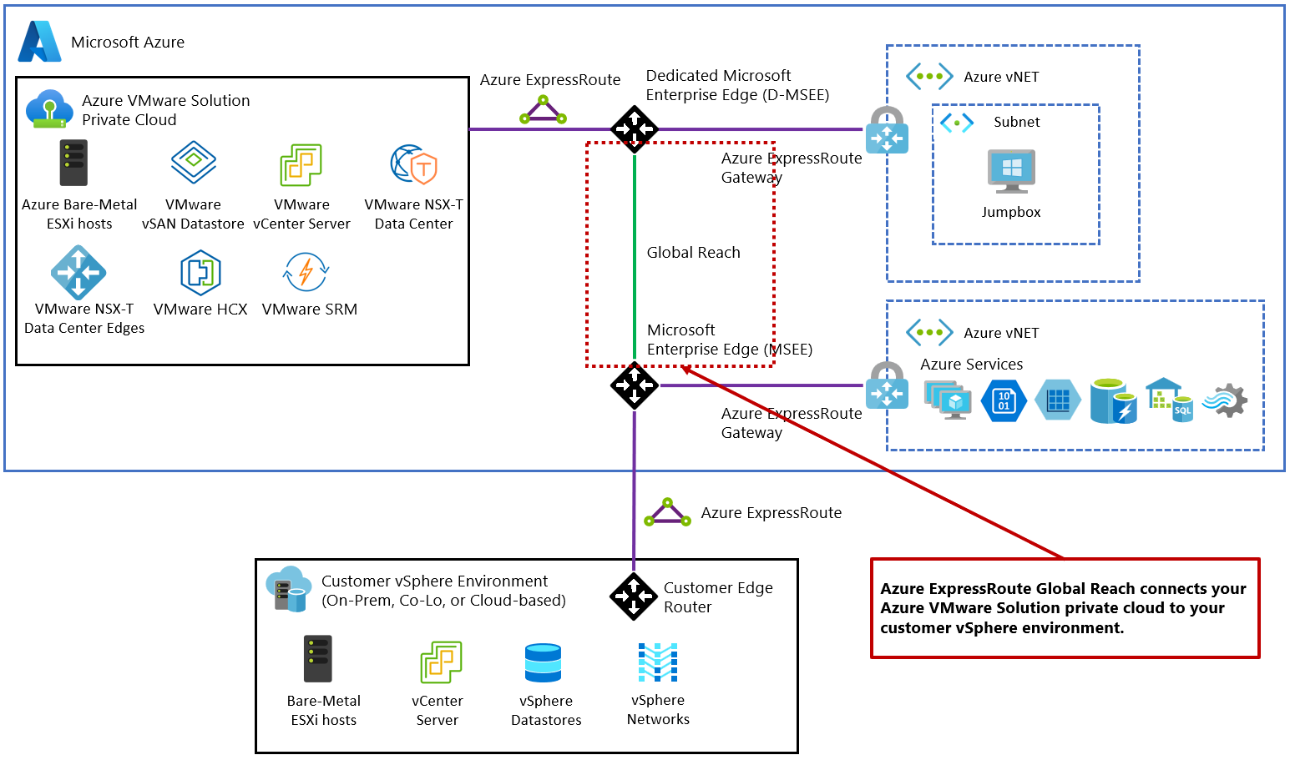
Azure VMWare Cloud Solution
Azure provides dedicated, VMWare private cloud solution on Azure for the specific VMWare workloads.
Ideal for;
Migrating the existing VMWare solution to the Cloud.
Increasing the existing VMWare capacity.
Building the VMWare and Azure native solution architecture.

Slide 11
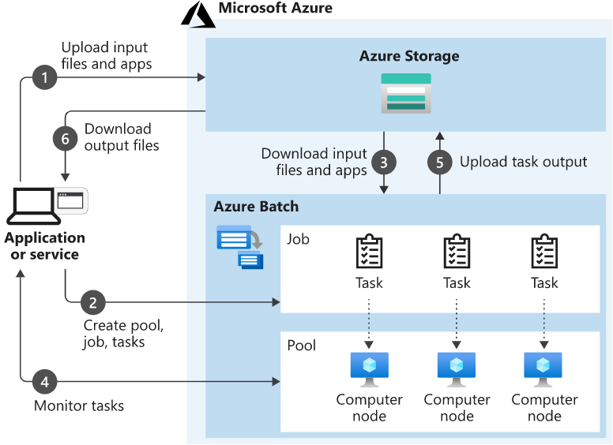
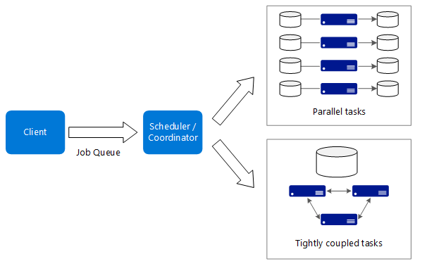
HIGH PERFORMANCE COMPUTING (hpc)
High-performance computing (HPC), also called "big compute", uses a large number of CPU or GPU-based computers to solve complex mathematical tasks.
Many industries use HPC to solve some of their most difficult problems. These include workloads such as; Genomics, Oil and gas simulations, Finance, Semiconductor design, Engineering, Weather modeling, etc.
Specific H-Series (High CPU load) or N-Series (NVIDIA supported high GPU load) VMs are used for this purpose.
Azure Batch service is used to manage tasks and parallel computing.
Some use cases are; finite element analysis, computer aided design, 3D model rendering, DNA analysis, fluid dynamics…

Slide 12
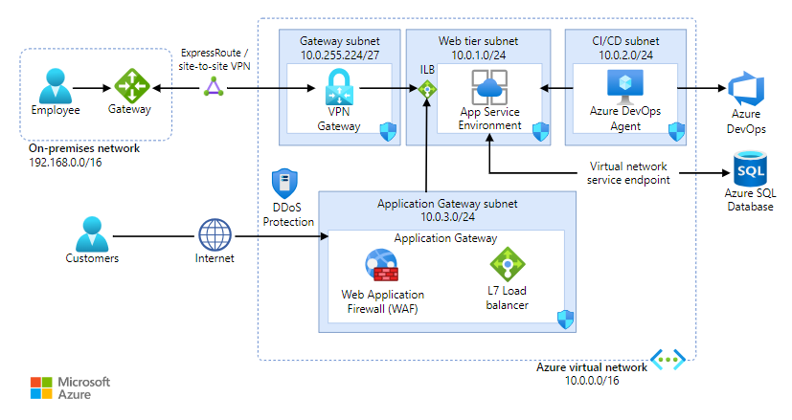
APP SERVICES
HTTP based App Service enables you to build and host web apps, background jobs, mobile back-ends, and RESTful APIs in the programming language of your choice without managing infrastructure.
App Service is a PaaS platform and despite IaaS solutions, infrastructure is managed by Azure.
Supports auto scaling with built-in auto scale mechanism.
Supports CI/CD processes with direct connections to various code sources like Azure DevOps, GitHub, Bitbucket, Dropbox, etc.

Slide 13
Lab Session

Slide 14
LAB#6: Testing COMPUTE INSTANCES ON CLOUD
VM Creation
Changing the VM type
Changing the VM image && Backup & Re-use of the VM Image
Follow the provided instructions.

Slide 15
LAB#7: Testing COMPUTE INSTANCES ON CLOUD
VMSS Setup and test
Follow the provided instructions.

Slide 16
LAB#8: Testing COMPUTE INSTANCES ON CLOUD
App Service installation and test
Follow the instructions: https://learn.microsoft.com/en-gb/training/modules/host-a-web-app-with-azure-app-service/1-introduction

Slide 17
HOMEWORK
Compare AWS and Azure’s Compute services (except serverless). Provide a short summary.
Research and provide a summary about Cloud Infrastructure automation solutions.
Search about Unikernel infrastructures and provide a short summary.
Try to learn more about Network:
IPv4 Addressing #1: https://www.youtube.com/watch?v=3ROdsfEUuhs (40 min. watch)
IPv4 Addressing #2: https://www.youtube.com/watch?v=FiAatRd84XI (30 min. watch)

Slide 18
Thank You

